Slide 1

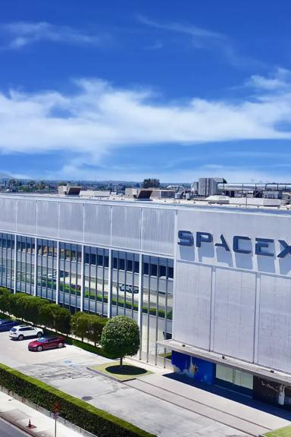


IBM SpaceX Capstone Project
Welcome to the IBM SpaceX Capstone Project! Join us on a journey to explore the goals, process, findings, and impact of this groundbreaking collaboration.
Saghar Ganji
E-Mail : sagharganji82@gmail.com

Slide 2
Goals of the Project
Advancing Space Exploration
Improving Data Analysis
Develop innovative solutions to enhance space exploration technologies and capabilities.
Leverage IBM's expertise in data analytics to support SpaceX's mission in acquiring and interpreting crucial data.
Enhancing Collaboration
Creating Commercial Opportunities
Foster collaboration between leading organizations in tech and space industries to push boundaries and drive progress.
Identify potential commercial applications and spin-off technologies from the project.

Slide 3
Outline
1
Executive Summary
Introduction
2
3
Methodology
Results
4
5
Conclusion
Appendix
6

Slide 4

﻿Executive Summary
Collected data from public SpaceX API and SpaceX Wikipedia page. Created labels column ‘class’ which classifies successful landings. Explored data using SQL, visualization, folium maps, and dashboards. Gathered relevant columns to be used as features. Changed all categorical variables to binary using one hot encoding. Standardized data and used GridSearchCV to find best parameters for machine learning models. Visualize accuracy score of all models.
Four machine learning models were produced: Logistic Regression, Support Vector Machine, Decision Tree Classifier, and K Nearest Neighbors. All produced similar results with accuracy rate of about 83.33%. All models over predicted successful landings. More data is needed for better model determination and accuracy.

Slide 5

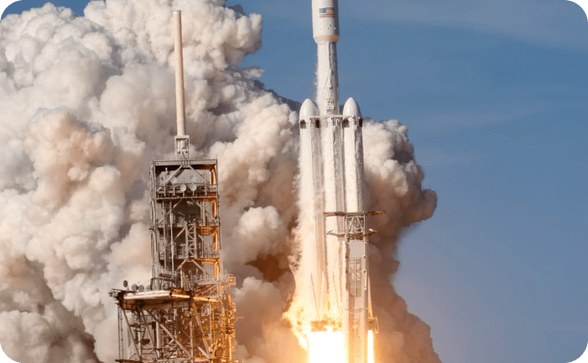
Introduction to IBM and SpaceX
IBM
SpaceX
International Business Machines Corporation (IBM) is a global technology company focused on AI, cloud computing, and cybersecurity.
Space Exploration Technologies Corp. (SpaceX) is a private aerospace manufacturer and space transportation company led by Elon Musk.

Slide 6
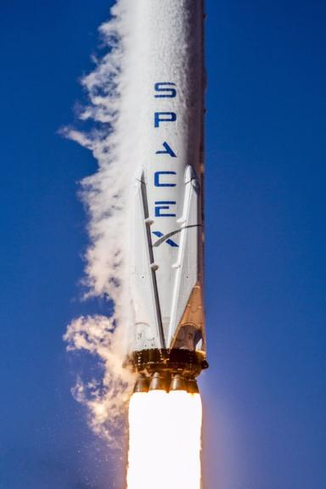
In the backdrop of this project lies my affiliation with SpaceX, specifically focusing on predicting the outcomes of the Falcon 9 first stage. The significance of accurately forecasting whether the rockets will successfully land cannot be overstated, as failures would entail considerable resource expenditures for the company.
Key Questions to Address:
1.What factors contribute to the failure of the landing process?
2.Can we reliably predict the successful landing of the rockets?
3.What level of accuracy can be achieved in forecasting successful landings?
These pivotal questions underscore the project's mission to identify critical variables influencing landing outcomes, establish a robust predictive model, and quantify the accuracy of our predictions in ensuring the success of Falcon 9 first stage landings.

Slide 7

Methodology
Executive Summary
• Data collection methodology:
• With Rest API and Web Scraping
• Perform data wrangling
• Data were transformed and one hot encoded to be apply later on the Machine Learning models
• Perform exploratory data analysis (EDA) using visualization and SQL
•Discovering new patterns in the data with visualization techniques such as scatter plots
• Perform interactive visual analytics using Folium and Plotly Dash
• Dash and Folium were used to achieve this goal
• Perform predictive analysis using classification models
• Classification machine learning models were built to achieve this goal

Slide 8

Data Collection
Data collection process involved a combination of API requests from Space X public API and web scraping data from a table in Space X’s Wikipedia entry.
The next slide will show the flowchart of data collection from API and the one after will show the flowchart of data collection from webscraping.
Space X API Data Columns:
FlightNumber, Date, BoosterVersion, PayloadMass, Orbit, LaunchSite, Outcome, Flights, GridFins,
Reused, Legs, LandingPad, Block, ReusedCount, Serial, Longitude, Latitude
Wikipedia Webscrape Data Columns:
Flight No., Launch site, Payload, PayloadMass, Orbit, Customer, Launch outcome, Version Booster, Booster landing, Date, Time

Slide 9


Data Collection – SpaceX API
1
Request (Space X APIs)
2
.JSON file + Lists(Launch Site, Booster Version, Payload Data)
3
Json_normalize to DataFrame data from JSON
4
Dictionary relevant data
5
Cast dictionary to a DataFrame
6
Filter data to only include Falcon 9 launches
7
Imputate missing PayloadMass values with mean
GitHub repo:

Slide 10


Data Collection – Web Scraping
1
Request Wikipedia
2
BeautifulSoup
3
Find launch info html table
html
html5lib Parser
4
Create dictionary
5
Iterate through table cells to extract data to the dictionary
6
Cast dictionary to DataFrame
GitHub repo:

Slide 11

Data Wrangling
Generate a training label for landing outcomes, assigning a value of 1 for success and 0 for failure. The Outcome column encompasses two elements: 'Mission Outcome' and 'Landing Location.'
Introduce a new training label column called 'class,' assigning a value of 1 if 'Mission Outcome' is True and 0 otherwise. Implement the following value mapping:
True ASDS, True RTLS, & True Ocean → set to 1
None None, False ASDS, None ASDS, False Ocean, False RTLS → set to 0
GitHub repo:

Slide 12


EDA with Data Visualization
Conducted Exploratory Data Analysis (EDA) on key variables including Flight Number, Payload Mass, Launch Site, Orbit, Class, and Year.
Utilized the following plots for analysis:
Flight Number vs. Payload Mass
Flight Number vs. Launch Site
Payload Mass vs. Launch Site
Orbit vs. Success Rate
Flight Number vs. Orbit
Payload vs. Orbit
Success Yearly Trend
Employed scatter plots, line charts, and bar plots to discern relationships between variables. This analysis aimed to identify existing connections that could be utilized in training the machine learning model.
GitHub repo:

Slide 13

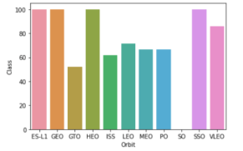
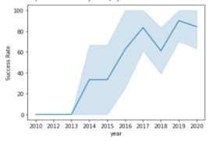
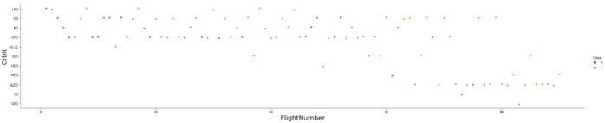
EDA with Data Visualization
Line chart between Year and Success rate Line chart between Year and Success rate
Scatter plot between Orbit and FlightNumber

Slide 14


EDA with SQL
I employed SQL queries to address the following inquiries:
Retrieve the names of unique launch sites involved in the space missions.
Display 5 records where launch sites begin with the string 'CCA'.
Determine the total payload mass carried by boosters launched by NASA (CRS).
Calculate the average payload mass carried by booster version F9 v1.1.
Identify the date of the first successful landing outcome on an in-ground pad.
List the names of boosters achieving success on a drone ship with a payload mass greater than 4000 but less than 6000.
Provide the total number of successful and failed mission outcomes.
List the names of booster versions carrying the maximum payload mass, using a subquery.
Detail failed landing outcomes on drone ships, including their booster versions and launch site names for the year 2015.
Rank the count of landing outcomes (such as Failure (drone ship) or Success (ground pad)) between the dates 2010-06-04 and 2017-03-20 in descending order.
GitHub repo:

Slide 15
Build an interactive map with Folium
Utilized folium.Marker() to generate markers on the maps, enhancing visual representation. Employed folium.Circle() to create circles above markers, adding a dynamic layer to the map. Leveraged folium.Icon() to establish custom icons for specific locations on the map.
For creating connections, folium.PolyLine() was implemented to craft a polynomial line between points, while folium.plugins.AntPath() was applied to introduce an animated line, enhancing the visual appeal of the connection.
To streamline maps with multiple markers sharing identical coordinates, the markerCluster() function was employed, providing a more organized and simplified display.
GitHub repo:

Slide 16


Build a Dashboard with Plotly Dash
Constructed a dynamic Dashboard using Plotly Dash:
Employed Dash and HTML components as the backbone of the Dashboard, serving as the pivotal elements for integrating graphs, tables, dropdowns, and other essential features.
Simplified data manipulation tasks by leveraging Pandas to create and manage the dataframe seamlessly.
Utilized Plotly for graph plotting, with a focus on employing Pie charts and Scatter charts to enhance data visualization.
Implemented a Rangeslider to facilitate convenient selection within the payload mass range.
Incorporated a Dropdown feature for launch sites, enhancing user interactivity and providing a more tailored experience.
GitHub repo:

Slide 17


Predictive analysis(Classification)
1
2
3
Building the model
Evaluating the model
Finding the optimal model
1) Create column for the class. 2) Standardize the data. 3) Split the data info train and test sets. 4) Build GridSearchCV model and fit the data.
1) Calculating the accuracies. 2) Calculating the confusion matrixes. 3) Plot the results .
1) Find the best hyperparameters for the models. 2) Find the best model with highest accuracy
3) Confirm the optimal model.

Slide 18

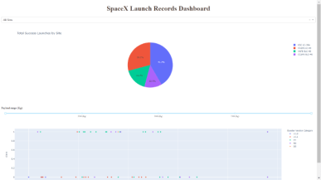
Results
This is a preview of the Plotly dashboard. The following sides will show the results of EDA with visualization, EDA with SQL, Interactive Map with Folium, and finally the results of our model with about 83% accuracy.

Slide 19

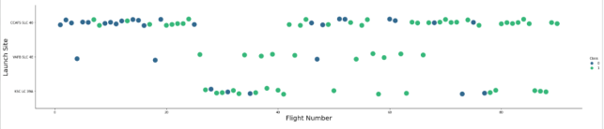
EDA with Visualization
Flight Number vs. Launch Site
Green indicates successful launch; Blue indicates unsuccessful launch.
Graphic suggests an increase in success rate over time (indicated in Flight Number). Likely a big breakthrough around flight 20 which significantly increased success rate. CCAFS appears to be the main launch site as it has the most volume.

Slide 20

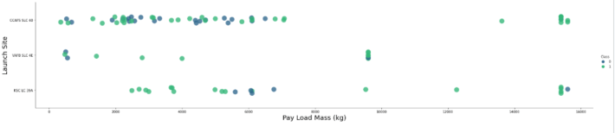
Payload vs. Launch Site
Green indicates successful launch; Purple indicates unsuccessful launch.
Payload mass appears to fall mostly between 0-6000 kg. Different launch sites also seem to use different payload mass.

Slide 21
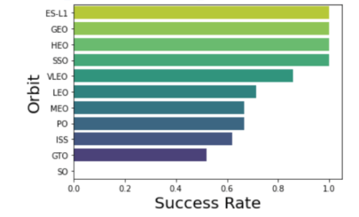
Success rate vs. Orbit type
Success Rate Scale with 0 as 0%
0.6 as 60% 1 as 100%
ES-L1 (1), GEO (1), HEO (1) have 100% success rate (sample sizes in parenthesis) SSO (5) has 100% success rate
VLEO (14) has decent success rate and attempts
SO (1) has 0% success rate
GTO (27) has the around 50% success rate but largest sample

Slide 22

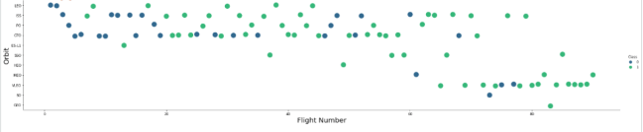
Flight Number vs. Orbit type
Green indicates successful launch; Blue indicates unsuccessful launch.
Launch Orbit preferences changed over Flight Number. Launch Outcome seems to correlate with this preference.
SpaceX started with LEO orbits which saw moderate success LEO and returned to VLEO in recent launches SpaceX appears to perform better in lower orbits or Sun-synchronous orbits

Slide 23

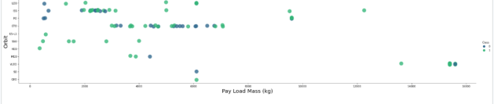
Payload vs. Orbit type
Green indicates successful launch; Purple indicates unsuccessful launch.
Payload mass seems to correlate with orbit
LEO and SSO seem to have relatively low payload mass
The other most successful orbit VLEO only has payload mass values in the higher end of the range

Slide 24

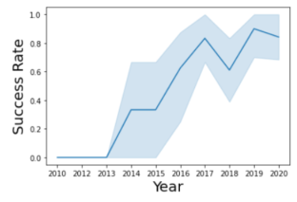
Launch Success Yearly Trend
95% confidence interval (light blue shading)
Success generally increases over time since 2013 with a slight dip in 2018
Success in recent years at around 80%

Slide 25

EDA with SQL
EXPLORATORY DATA ANALYSIS WITH SQL DB2 INTEGRATED IN PYTHON WITH SQLALCHEMY

Slide 26

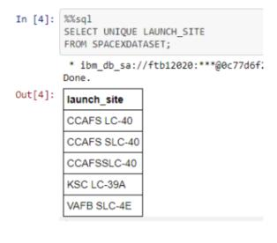
All Launch Site NamesTitle
Query unique launch site names from database.
CCAFS SLC-40 and CCAFSSLC-40 likely all represent the same
launch site with data entry errors.
CCAFS LC-40 was the previous name.
Likely only 3 unique launch_site values: CCAFS SLC-40, KSC LC-39A, VAFB SLC-4E

Slide 27

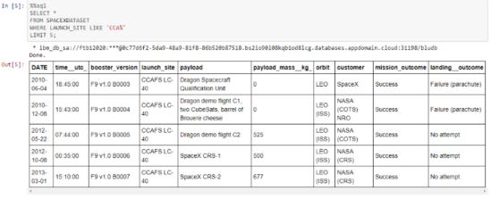
Launch Site Names Beginning with "CCA"
First five entries in database with Launch Site name beginning with CCA.

Slide 28
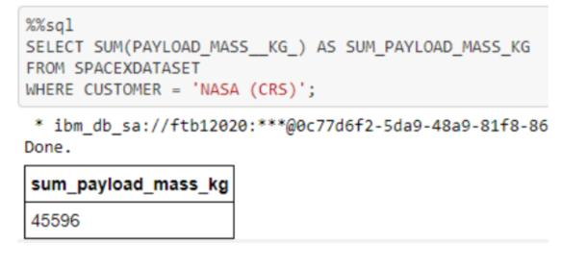
Total Payload Mass from NASA
This query sums the total payload mass in kg where NASA was the customer.
CRS stands for Commercial Resupply Services which indicates that these payloads were sent to the International Space Station (ISS).

Slide 29
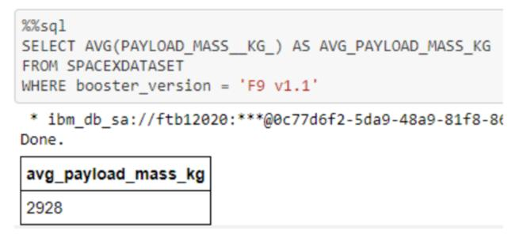
Average Payload Mass by F9 v1.1
This query calculates the average payload mass or launches which used booster version F9 v1.1
Average payload mass of F9 1.1 is on the low end of our payload mass range

Slide 30

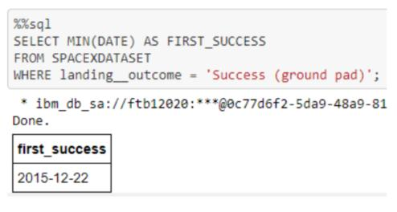
First Successful Ground Pad Landing Date
This query returns the first successful ground pad landing date.
First ground pad landing wasn’t
until the end of 2015.
Successful landings in general
appear starting 2014.

Slide 31

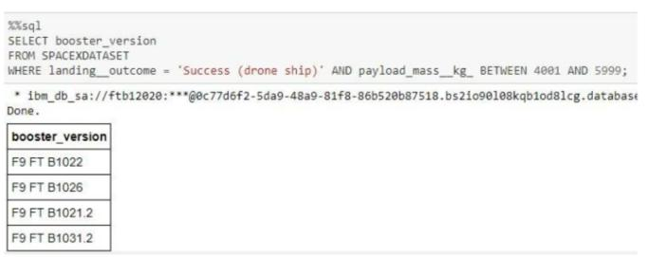
Successful Drone Ship Landing with Payload Between 4000 and 6000
This query returns the four booster versions that had successful drone ship landings and a payload mass between 4000 and 6000 noninclusively.

Slide 32

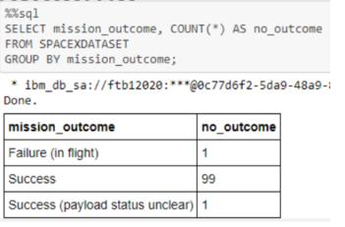
Total Number of Each Mission Outcome
This query returns a count of each
mission outcome.
SpaceX appears to achieve its mission outcome nearly 99% of the time.
This means that most of the landing
failures are intended.
Interestingly, one launch has an unclear payload status and unfortunately one failed in flight.

Slide 33

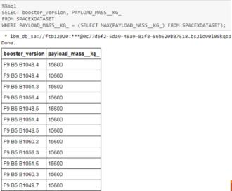
Boosters that Carried Maximum Payload
This query returns the booster versions that carried the highest payload mass of 15600 kg.
These booster versions are very similar and all are of the F9 B5 B10xx.x variety.
This likely indicates payload mass correlates with the booster version that is used.

Slide 34
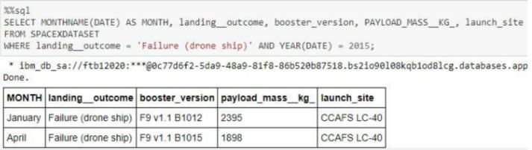
2015 Failed Drone Ship Landing Records
This query returns the Month, Landing Outcome, Booster Version, Payload Mass (kg), and Launch site of 2015 launches where stage 1 failed to land on a drone ship.
There were two such occurrences.

Slide 35
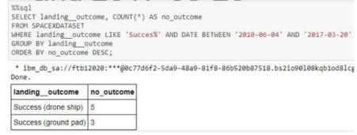
Ranking Counts of Successful Landings Between 2010-06-04 and 2017-03-20
This query returns a list of successful landings and between 2010-06-04 and 2017-03-20 inclusively.
There are two types of successful landing outcomes: drone ship and ground pad landings.
There were 8 successful landings in total during this time period

Slide 36
Interactive Map with Folium

Slide 37

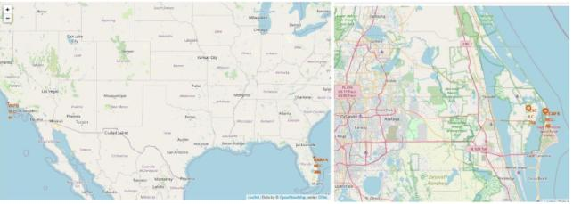
Launch Site Locations
The left map shows all launch sites relative US map. The right map shows the two Florida launch sites since they are very close to each other. All launch sites are near the ocean.

Slide 38

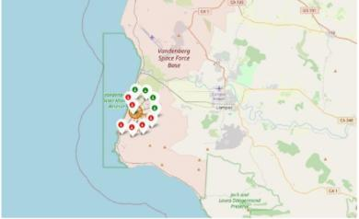
Color-Coded Launch Markers
Clusters on Folium map can be clicked on to display each successful landing (green icon) and failed
landing (red icon). In this example VAFB SLC-4E shows 4 successful landings and 6 failed landings.

Slide 39

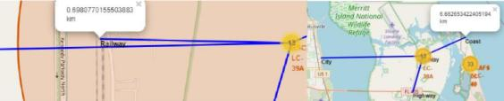
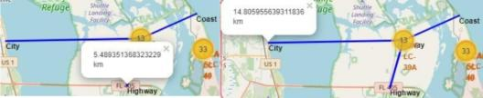
Key Location Proximities
Using KSC LC-39A as an example, launch sites are very close to railways for large part and supply transportation. Launch sites are close to highways for human and supply transport. Launch sites are also close to coasts and relatively far from cities so that launch failures can land in the sea to avoid rockets falling on densely populated areas.

Slide 40

Build a Dashboard with Plotly Dash

Slide 41

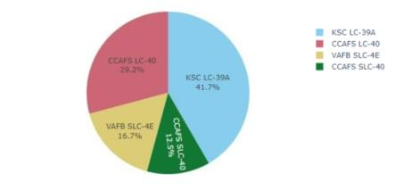
Successful Launches Across Launch Sites
This is the distribution of successful landings across all launch sites. CCAFS LC-40 is the old name of CCAFS SLC-40 so CCAFS and KSC have the same amount of successful landings, but a majority of the successful landings where performed before the name change. VAFB has the smallest share of successful landings. This may be due to smaller sample and increase in difficulty of launching in the west coast.

Slide 42

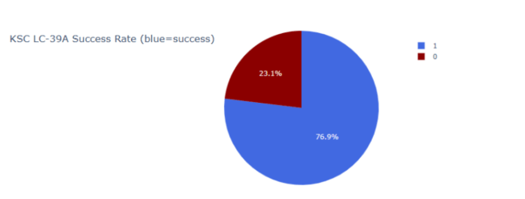
Highest Success Rate Launch Site
KSC LC-39A has the highest success rate with 10 successful landings and 3 failed landings.

Slide 43

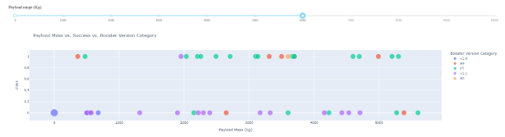
Payload Mass vs. Success vs. Booster Version Category
Plotly dashboard has a Payload range selector. However, this is set from 0-10000 instead of the max Payload of 15600. Class indicates 1 for successful landing and 0 for failure. Scatter plot also accounts for booster version category in color and number of launches in point size. In this particular range of 0-6000, interestingly there are two failed landings with payloads of zero kg.

Slide 44

Predictive Analysis (Classification)
GRIDSEARCHCV(CV=10) ON LOGISTIC REGRESSION, SVM, DECISION
TREE,ANDKNN

Slide 45

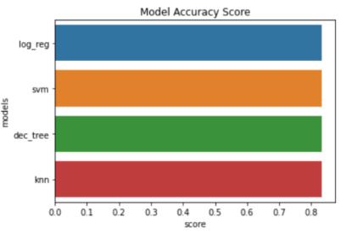
Classification Accuracy
All models had virtually the same accuracy on the test set at 83.33% accuracy. It should be noted that test size is small at only sample size of 18.
This can cause large variance in accuracy results, such as those in Decision Tree Classifier model in repeated runs.
We likely need more data to determine the best model.

Slide 46

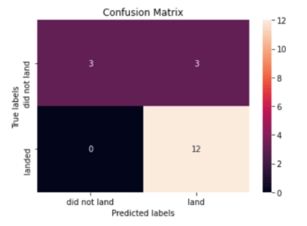
Confusion Matrix
Correct predictions are on a diagonal from top left to bottom right.
Since all models performed the same for the test set, the confusion matrix is the same across all models. The models predicted 12 successful landings when the true label was successful landing.
The models predicted 3 unsuccessful landings when the true label was unsuccessful landing.
The models predicted 3 successful landings when the true label was unsuccessful landings (false positives). Our models over predict successful landings.

Slide 47
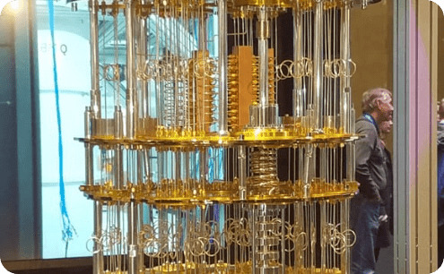
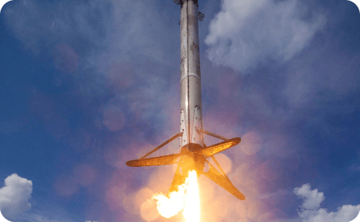

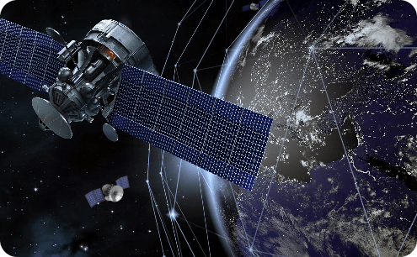
Key Findings and Solutions
Quantum Computing
Reusable Rockets
Exploring the potential of quantum computing to develop more sophisticated space mission simulations and optimization algorithms.
Designing and refining reusable rocket technology to significantly reduce the cost of space missions.
AI-Driven Automation
Global Satellite Network
Leveraging artificial intelligence to automate various processes involved in space exploration and data analysis.
Building a global satellite network to enhance communication and data transmission capabilities.

Slide 48
CONCLUSION
Our objective was to develop a cutting-edge machine learning model for SpaceY, aiming to compete with SpaceX. The primary focus of the model is to forecast the successful landing of Stage 1 rockets, potentially saving up to $100 million USD per launch.
To achieve this, we leveraged data from a publicly accessible SpaceX API and conducted web scraping on the SpaceX Wikipedia page. This diverse dataset was meticulously labeled, and the information was stored in a robust DB2 SQL database. Additionally, we designed an intuitive dashboard for effective data visualization.
Our machine learning model, boasting an impressive accuracy rate of 83%, serves as a powerful tool for Allon Mask and the SpaceY team. With this model, they can make informed predictions regarding the likelihood of a successful Stage 1 landing before the launch, facilitating crucial decisions on whether to proceed with the launch.
While the current model delivers a commendable level of accuracy, we recommend further data collection efforts to refine and optimize the machine learning model. Gathering additional data will not only contribute to a more comprehensive understanding of the underlying patterns but also enhance the accuracy of predictions, ensuring SpaceY remains at the forefront of space exploration technology.

Slide 49

Conclusion and Next Steps
Successful Collaboration
The IBM SpaceX Capstone Project exemplifies the power of collaboration between tech giants and space pioneers.
Continued Innovation
Continued research, development, and innovation will drive the future of space exploration and commercial space endeavors.
Inspiring Future Generations
This project inspires the next generation of scientists and engineers to push the boundaries of what's possible in space.

Slide 50

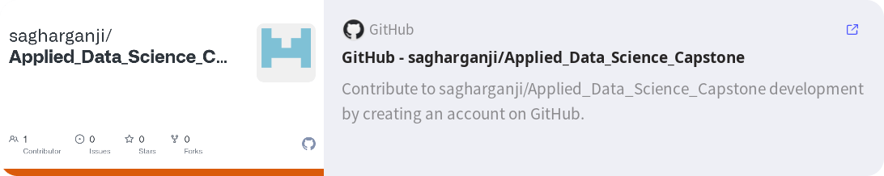
APPENDIX
GitHub repository url:
Instructors:
Instructors: Rav Ahuja, Alex Aklson, Aije Egwaikhide, Svetlana Levitan, Romeo Kienzler, Polong Lin, Joseph Santarcangelo, Azim Hirjani, Hima Vasudevan, Saishruthi Swaminathan, Saeed Aghabozorgi, Yan Luo
Special Thanks to All Instructors:
https://www.coursera.org/professional-certificates/ibm-data-science?#instructors

Slide 51

Thank You!
We appreciate your time and attention. It has been a pleasure sharing our insights and ideas with you. If you have any further questions or would like to connect, please don't hesitate to reach out. Have a wonderful day!

